Slide 1


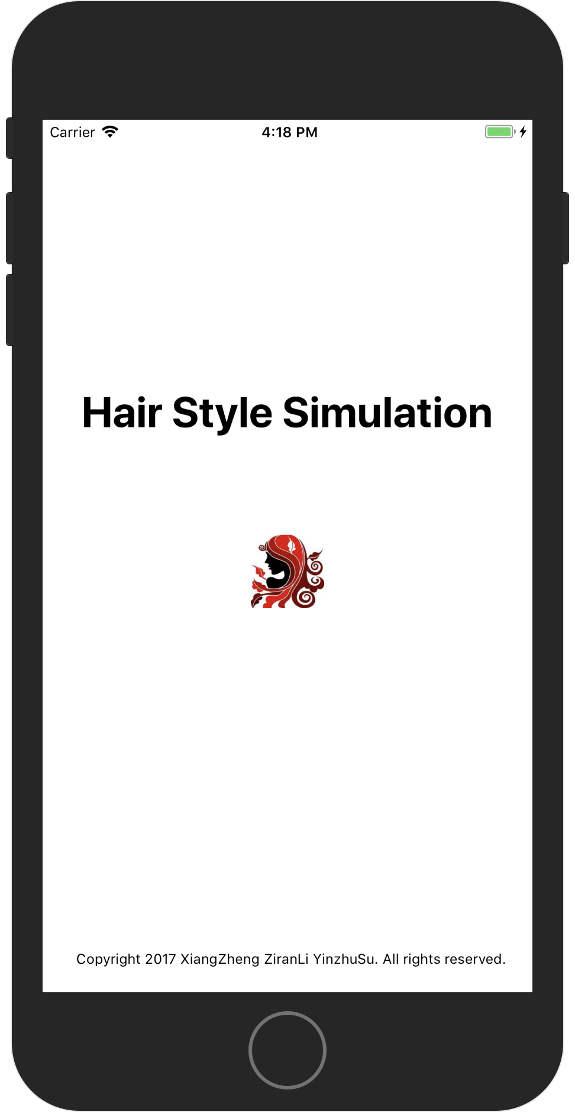
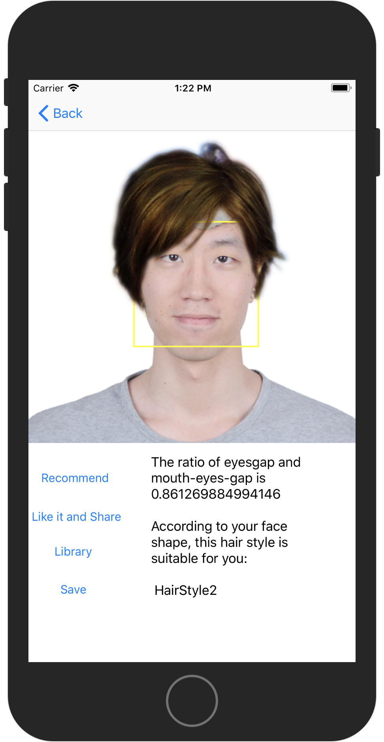

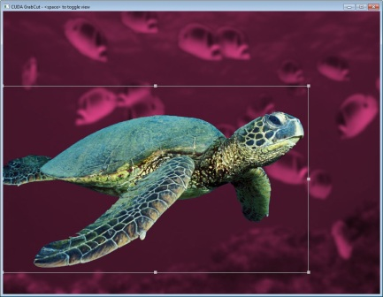
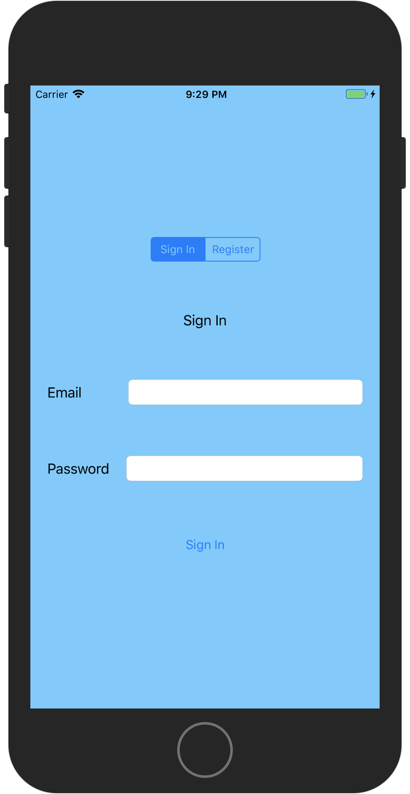
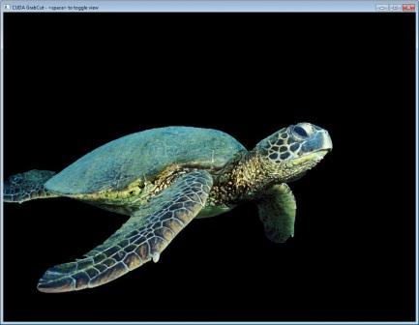
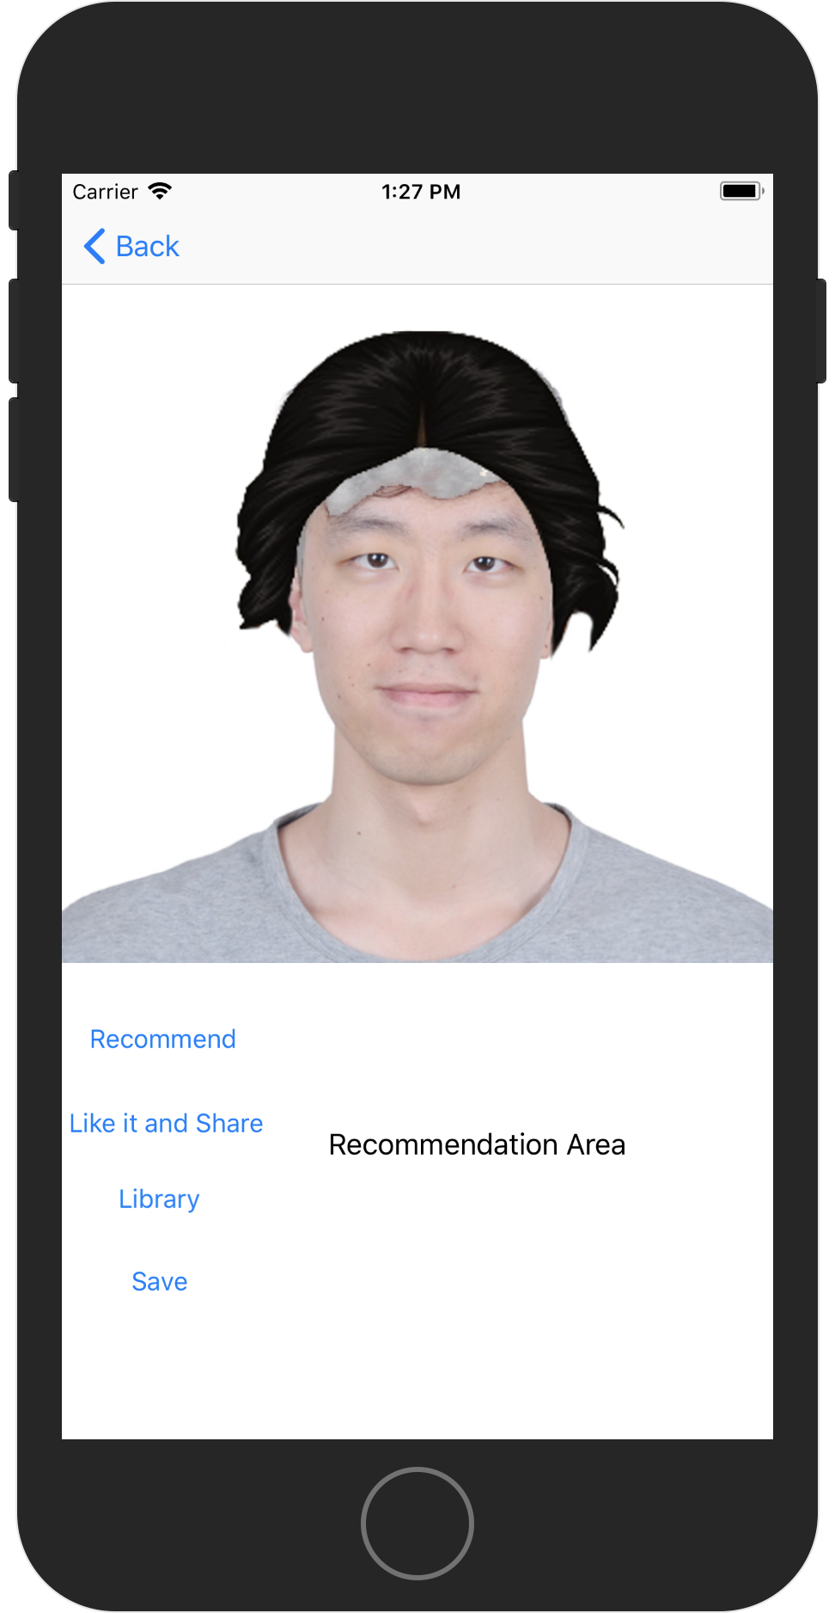
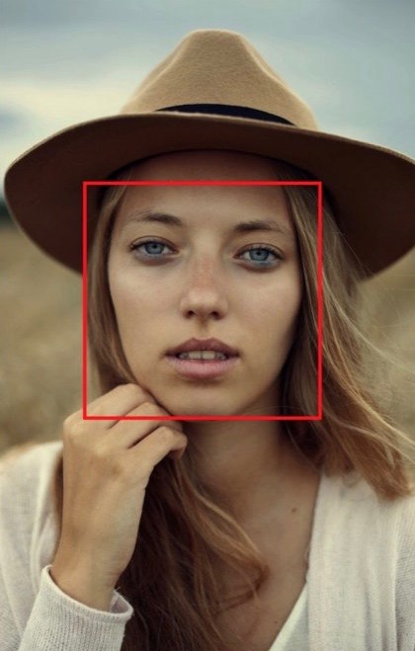
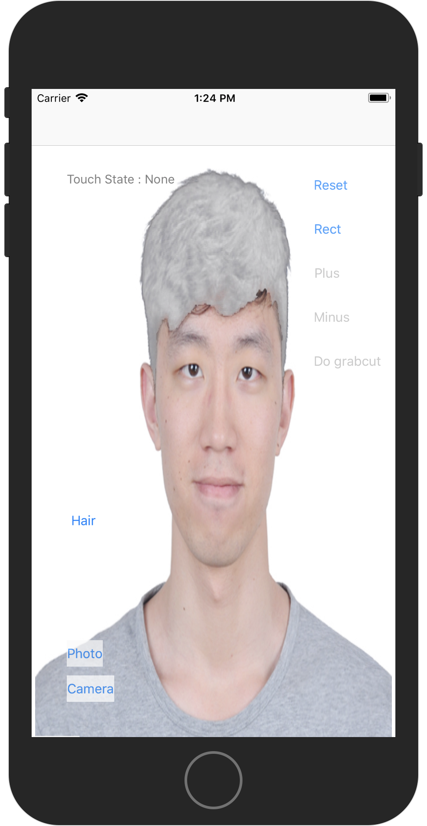
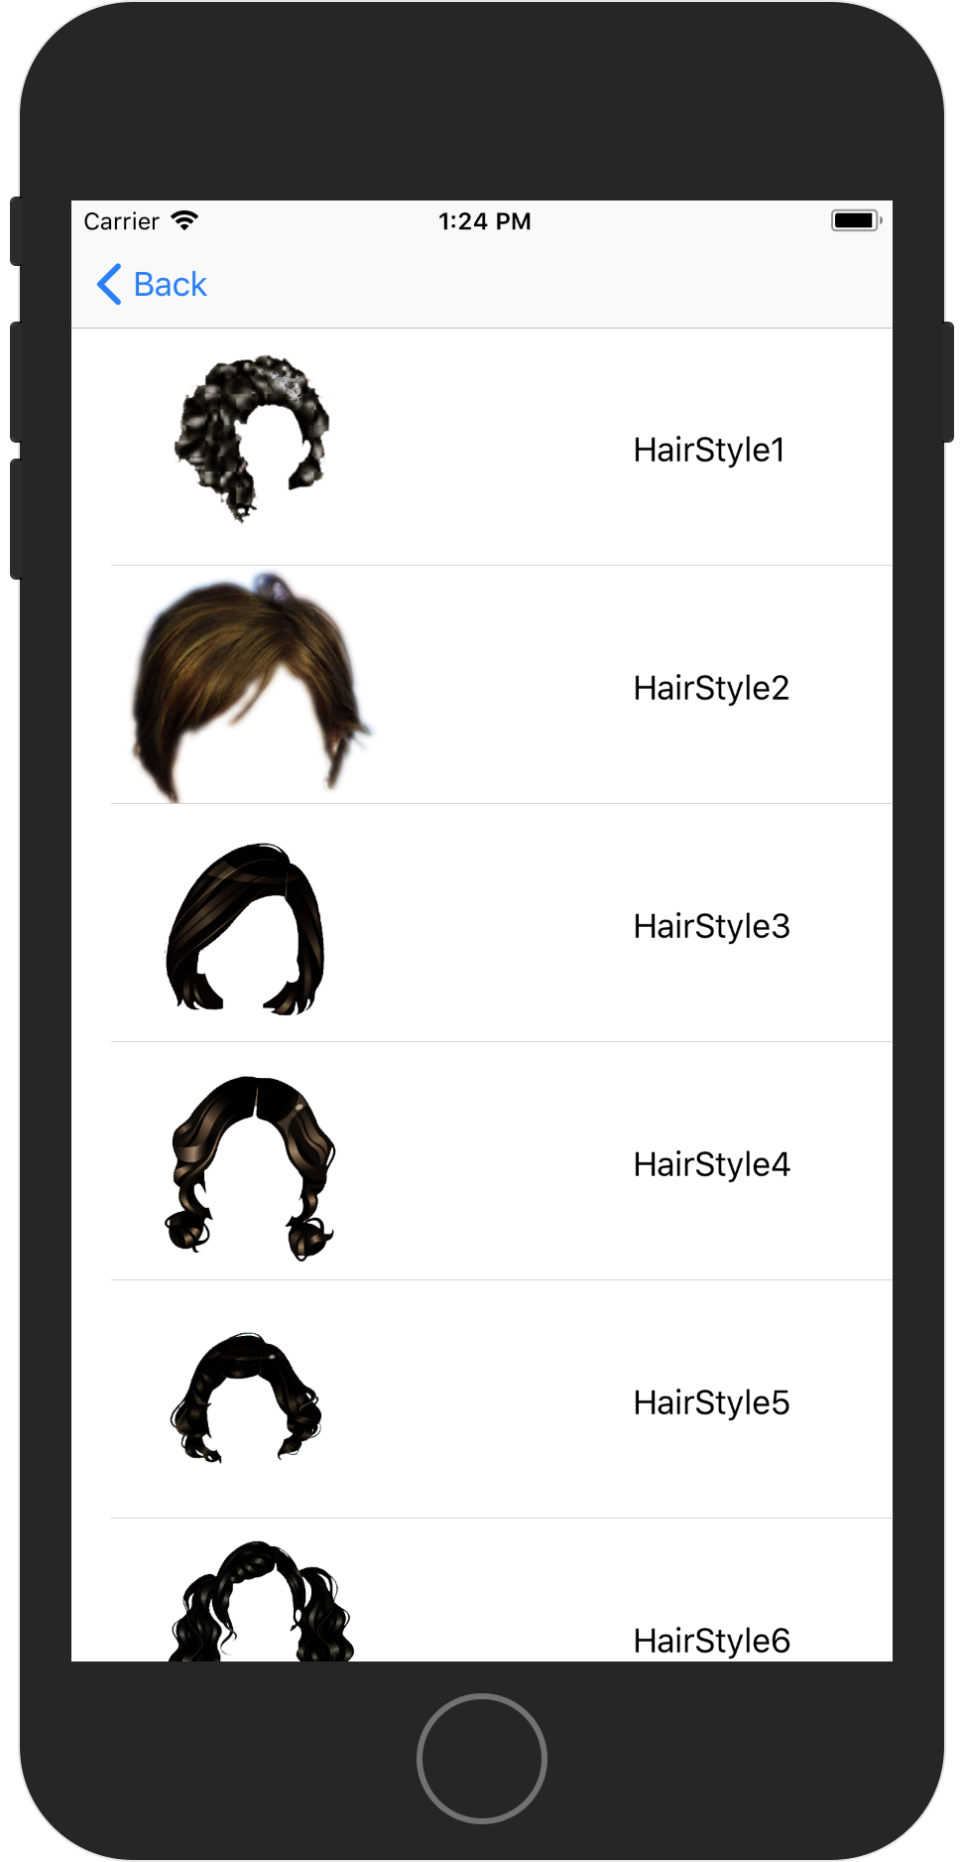


You deserve better hairstyles!
HAIRSTYLE SIMULATION
Xiang Zheng Ziran Li Yinzhu Su
Introduction
MAIN TECHNIQUE
Recommendation
iOS application
Detect human hair with user interaction
Remove the old one, try new hairstyles on!
GrabCut
Core Image algorithm
Based on face’s data, give hairstyle recommendation
An image segmentation algorithm based on graph cuts
Using a Gaussian mixture model, estimates the color distribution of the target object and background.
As this estimation is likely to be more accurate than the original, taken from the bounding box, this two-step procedure is repeated until convergence.
Estimation can be further corrected by the user by pointing out misclassified regions and rerunning the optimization. The method preserve edges.
Firebase
Match Your Face
Register with email
Already registered? Sign in!
Google Firebase
Hairstyle matching
Zooming Using the Pinch Gestures
Core Image
An image processing and analysis technology that provides high-performance processing for still and video images.
Use many built-in image filters to process images and build complex effects by chaining filters.
In our app, we use Core Image to detect human face and collect detailed information, such as eyes’ position and mouth’s position,
The data was sent to the backend of the app, then calculate the user’s face shape so that our app give recommended hairstyle according to their face shape.
GrabCut
Select Hairstyles
GrabCut algorithm
Interactive Foreground Extraction
Hairstyle selection
10 hairstyles till now
More will be uploaded
User Story
Accomplishments
Create an account via social media or email address.
Remove the hair.
Try different hairstyles matching with my face.
Get suggestions of hairstyles from the App.
Share my favorite picture to social networks.
Firebase login system.
Remove the hair in a picture using our App.
Try new hairstyles in the table view.
Get suggested hairstyles according to the face shape.
Share your favorite picture via e-mail.
Github
Trello

